Slide 1

Chicago Taxi Trips
MSDS 7330 Term Paper – Group D
Josh Balson
Cam Lu
Hieu Nguyen
Notes:
To change the image on this slide, select the picture and delete it. Then click the Pictures icon in the placeholder to insert your own image.

Slide 2
Abstract
The purpose of this research is to analyze taxi rides taken in Chicago from 2013 to 2016 to determine whether the city of Chicago is “centralized”
We will also analyze the question, “are taxis competing with the metro system by covering similar routes or supplementing metro routes by getting people to and from train stations?”
We will answer this question by analyzing the ratio of taxi rides where the destination was either to or from downtown compared to all taxi rides taken during the same time period
In order to study the questions above, we will use a data set provided by Kaggle (https://www.kaggle.com/chicago/chicago-taxi-rides-2016)
We also used the full data set provided by the City of Chicago (https://data.cityofchicago.org/Transportation/Taxi-Trips/wrvz-psew)

Slide 3

Related Work
Data set published by Kaggle
For 2016 only

Slide 4
Introduction

Slide 5
Background/Existing Work

Slide 6
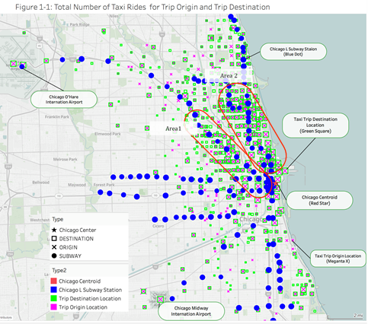
Our Analysis
Figure 1-1 displays the Chicago map with Chicago “L” Subway Lines station, trip origin, and trip destination
The data shows more concentrated passengers being picked up and dropped off along the “L” lines on the north west (area 1 and area 2) of Chicago Centroid location.
Further away from Chicago Centroid, area 1 and area 2, there are lot of less taxi passengers except Chicago O’Hare International Airport and Chicago Midway International airport.

Slide 7
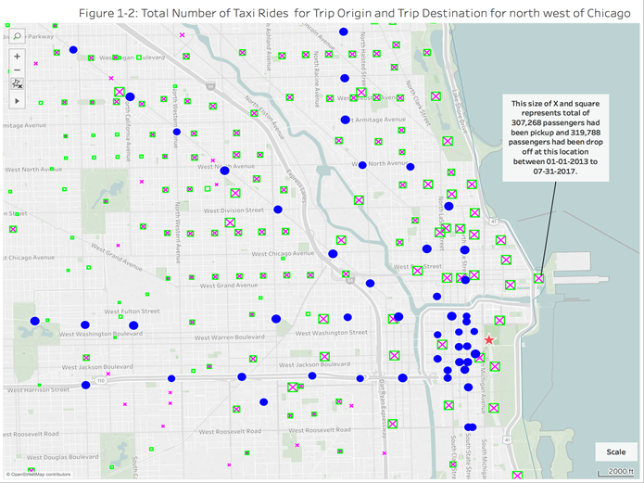
Our Analysis (cont’d)
Figure 1-2 displays the zoom area for Chicago north east region with map scale of 2000 ft. Most of locations for taxi pick up and drop passengers are a good distance away from “L” line station
The locations of taxi drop and pick off passenger are evenly distributed on the downtown area, especially the areas not covered by a subway station
This is a strong indication that taxis are not covering similar routes of the subway, but are supplementing public transit by getting people to and from downtown

Slide 8
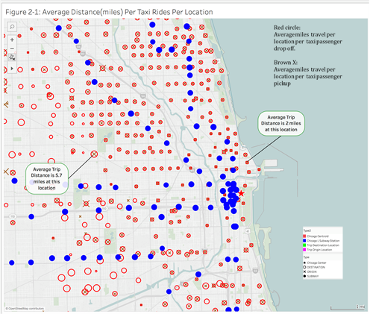
Our Analysis (cont’d)
Figure 2-1 displays the average distance traveled at each location for each passenger origin (magenta x) and destination (blue circle). A bigger x or circle represents a longer distance traveled.
The data shows short trips around 2 miles average distance in the region of Chicago downtown. This is an indication that passengers use the taxi for short trips for the areas in downtown that are not covered by the subway.
This is a strong indication that taxis are not covering similar routes of the subway, but are supplementing public transit by getting people to and from downtown

Slide 9
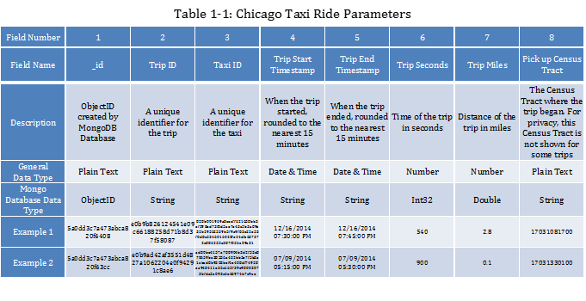
Appendix A

Slide 10
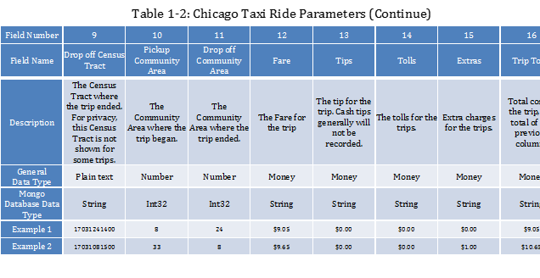
Appendix B

Slide 11
Appendix C

